Slide 1
Ophthalmic and Otic Medications
Chapter 18

Slide 2
Basic Anatomy & Physiology
The ocular system is responsible for vision
The ocular system is comprised of the eyes and adnexa
  Globe consists of three layers:
    Sclera (white of the eye), choroid (middle, vascular coat of the eye), and retina (“the film in the camera”)
  Adnexa consists of the surrounding structures:
    Orbit, eye muscles, eyelids, eyelashes, conjunctiva, and lacrimal apparatus

Slide 3
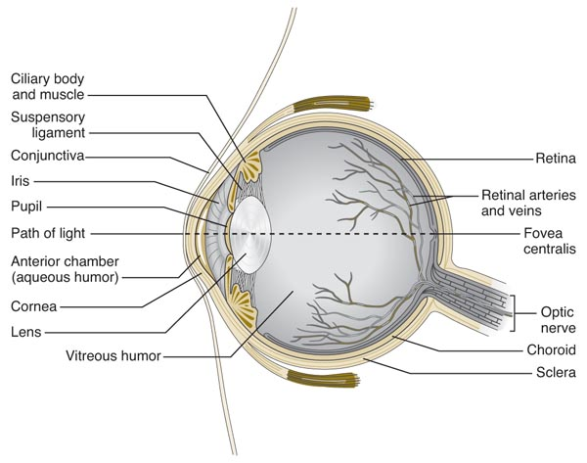
Basic Anatomy & Physiology

Slide 4
Ophthalmic Drugs
Things to consider when using topical ophthalmic drugs
  Drug penetration - They must be absorbed into the anterior chamber
  Frequency of drug application - They may be administered at different frequencies depending on whether they are in ointment or solution form
  Ease of application - They must be relatively easy to administer so that client compliance occurs

Slide 5
Diagnostic Ophthalmic Drugs
  Topical anesthetics such as proparacine and tetracaine are used to help perform comprehensive eye exams or to remove foreign material from the eye.
  Corneal anesthesia is accomplished in about one minute and lasts for about ten minutes.
  Store open bottles in refrigerator.
  Discard discolored solutions.
  Do not apply before performing STT!!!!

Slide 6
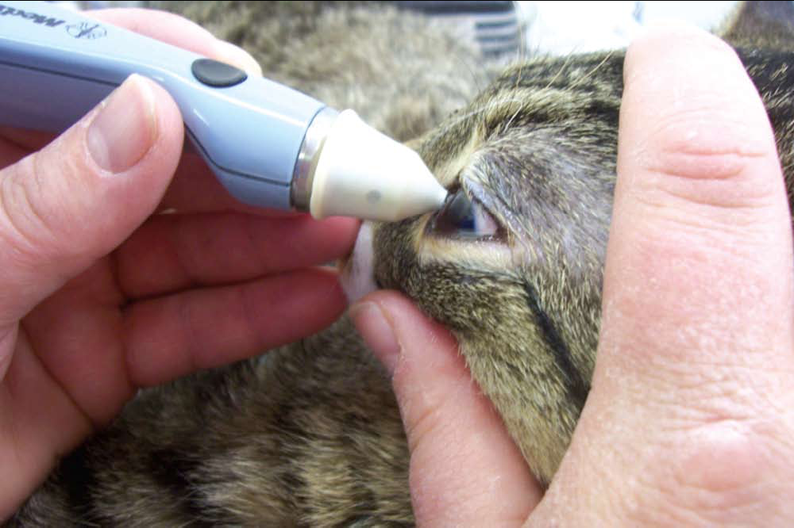
Tonometry (TonoPen®)

Slide 7
Diagnostic Ophthalmic Drugs
  Fluorescein sodium stain is applied to the cornea (using sterile saline) to assess any corneal defects (the stain is orange until it adheres to a corneal defect, where it appears green)
    Stain is fat soluble and therefore unable to penetrate or adhere to intact cornea (can only penetrate damaged tissues)
    Stain should be washed from the eye before and after examination is complete.
    Use a Wood’s Lamp to examine eye for abrasions.

Slide 8
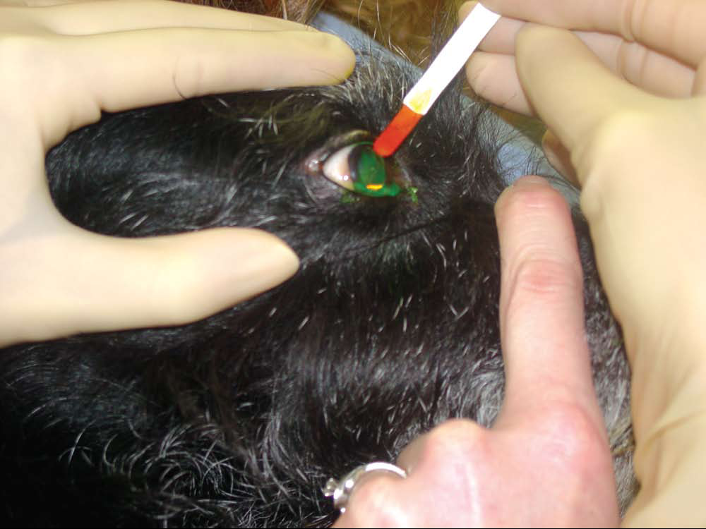
Fluorscein Stain

Slide 9
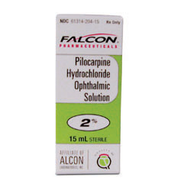
Miotics
  Cholinergic drugs that constrict the pupil
  Used to treat open-angle glaucoma because they decrease intraocular pressure.
  An example is pilocarpine (Piloptic®)

Slide 10
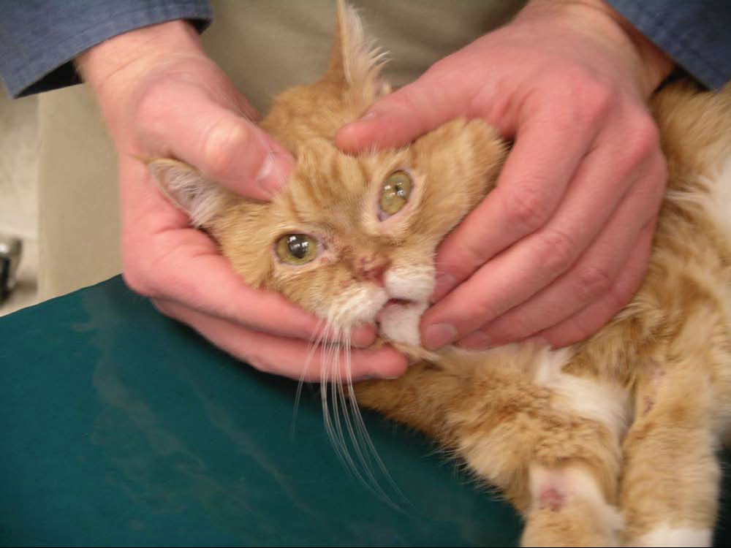
Miotics Constrict the Pupil

Slide 11
Mitotics vs. Mydriatics
Mitotics are cholinergic or sympatholytic drugs.
Mydriatics are sympathomimetic or anticholinergic drugs.

Slide 12
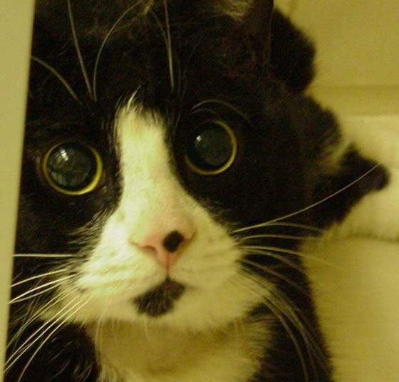
Mydriatics and Cycloplegics
Mydriatics dilate the pupil and are used to aid in eye exams, to relieve inflammation associated with uveitis (inflammation of the iris, ciliary body, and choroid) and keratitis (inflammation of the cornea), to break up or prevent adhesions between the iris and the lens, and to prepare an animal for ocular surgery
Cycloplegics paralyze the ciliary muscles and minimize pain

Slide 13
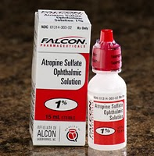
Atropine
Anticholinergic drug used for treatment of acute inflammation of anterior uvea and aid in exam of retina
Mydriasis and cycloplegia
Side effects = salivation
Contraindications: glaucoma (increases intraocular pressure); KCS (decreases tear production)
Solution or ointment

Slide 14
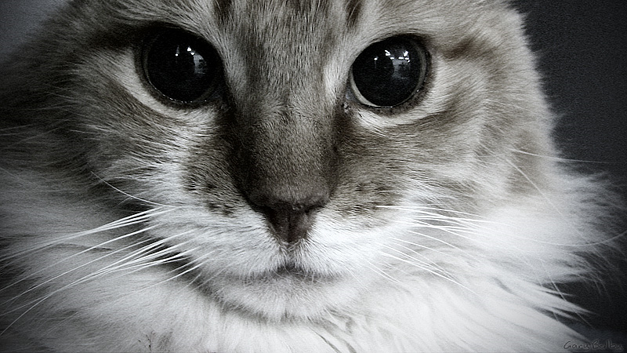
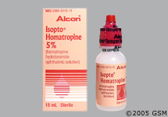
Homatropine
Same uses, side effects, and contraindications as atropine.
Faster onset and shorter duration of action than atropine
Isopto Homatropine®

Slide 15
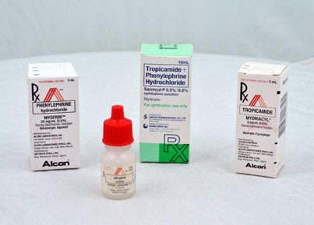
Phenylephrine
Sympathomimetic drug used to evaluate eye diseases such as uveitis and Horner’s syndrome
May be used prior to conjunctival surgery to decrease hemorrhage
Mydriasis/no cycoplegia
Produces vasoconstriction, ocular discomfort, tearing, and rebound miosis
Mydfrin®

Slide 16
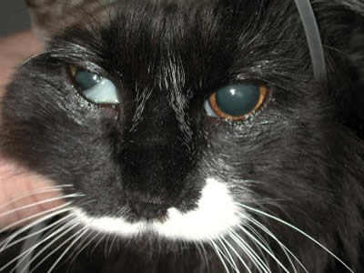
Horner’s Syndrome
Enophthalmos (backward displacement of eyeball into the orbit)
Ptosis of the upper eyelid
Slight elevation of the lower lid
Constriction of pupil
Narrowing of palpebral fissure

Slide 17
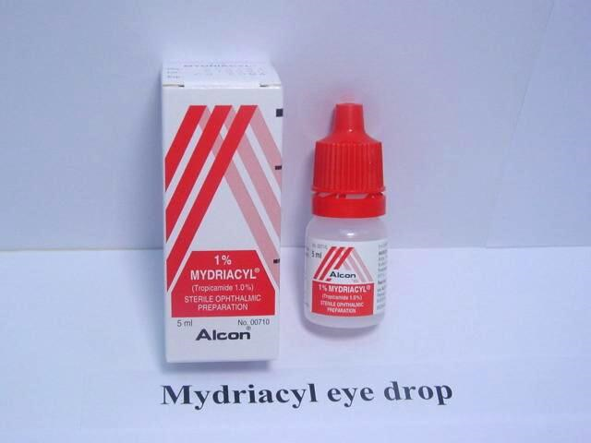
Tropicamide
Used for fundic examination
Rapid acting mydriatic with slight cycloplegic effect.
More rapid onset and shorter duration of action than atropine.
Side effects: local discomfort and salivation
Contraindicated in animals with glaucoma or KCS

Slide 18
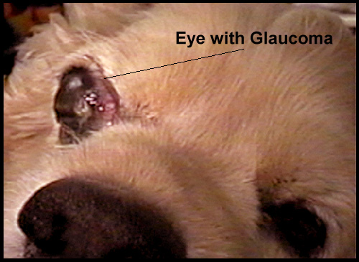
Epinephrine
Sympathomimetic drug that reduces intraocular pressure and produces mydriasis.
Used to prevent glaucoma in the unaffected eye
May cause ocular discomfort.

Slide 19
Glaucoma
Glaucoma is a group of diseases that increase intraocular pressure (drugs used to treat glaucoma decrease intraocular pressure)
Primary glaucoma: caused by an acquired structural defect within the eye
Secondary glaucoma: a consequence of another ocular disease or trauma
Congenital glaucoma: resulting from a genetic defect
If left untreated, glaucoma can result in blindness.

Slide 20
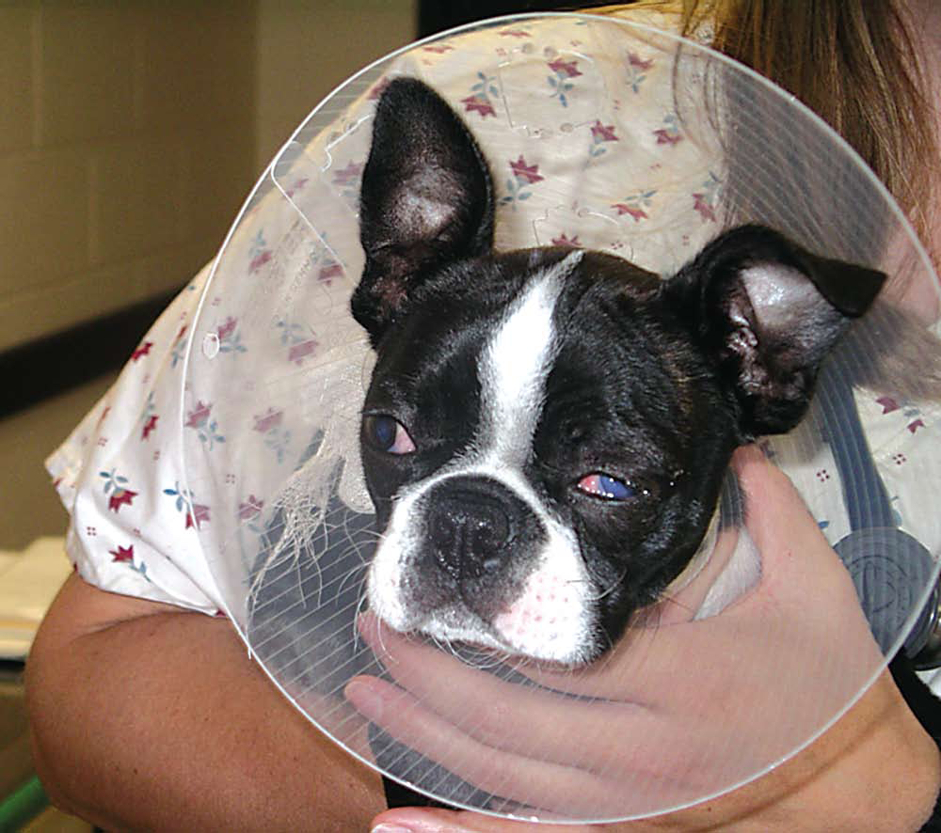
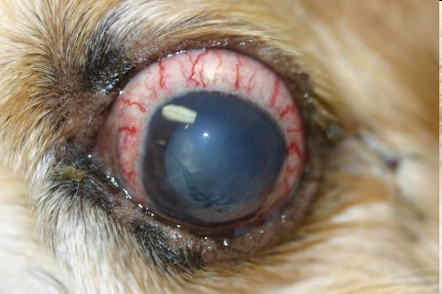
Glaucoma

Slide 21
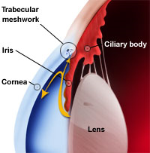
Narrow vs Open-Angle Glaucoma
Aqueous humor is constantly produced by ciliary process behind iris
  Production is controlled by carbonic anhydrase
Once aqueous humor enters eye, it passes from posterior chamber, through pupil, into anterior chamber, and is then drained through trabecular meshwork.
When intraocular pressure increases, outflow mechanism for aqueous humor is blocked

Slide 22
Narrow vs. Open-Angle Glaucoma (cont’d)
If iris occludes trabecular meshwork, normal outflow of humor is prevented, and animal is said to have narrow-angle glaucoma.
If there is no change in chamber angle of eye, but aqueous humor outflow is impeded because of degenerative changes, animal is said to have open-angle glaucoma.

Slide 23
Drugs Used to Treat Glaucoma
Miotics: covered previously
Carbonic anhydrase inhibitors interfere with the production of carbonic acid, leading to a decrease of aqueous humor production
    Examples include acetazolamide, dichlorphenamide, and methazolamide
Beta-adrenergic blockers decrease production of aqueous humor. Systemic side effects (bradycardia, hypotension, bronchospasms). Used with primary glaucoma to prevent development of disease in both eyes. May cause blurred vision.
    Examples include timolol maleate and betaxolol hydrochloride

Slide 24
Drugs Used to Treat Glaucoma
Osmotic diuretics: used prior to surgery or as an emergency treatment of glaucoma.
  Given IV to decrease vitreous humor volume and rapidly decrease intraocular pressure
  Side effects: electrolyte imbalances, cardiovascular problems, vomiting
    Examples include mannitol and glycerin

Slide 25
Drugs used to treat KCS
  KCS is a disease in which tear production is decreased, resulting in mucopurulent conjunctivitis and corneal scarring/ulceration
  Examples of drugs used to treat KCS:
    Artificial tears
    Antibiotic-steroid preparations
    Lacrimogenics (increase tear production) such as pilocarpine
    Immunomodulators (interfere with interleukin production by T-lymphocytes) such as cyclosporine

Slide 26
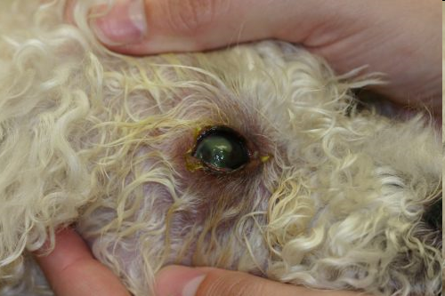
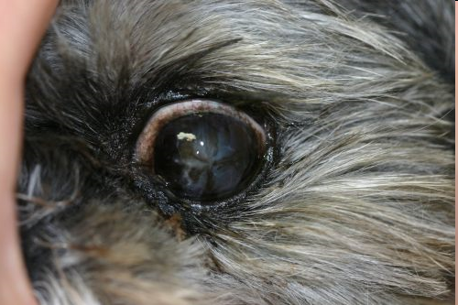
Keratoconjunctivitis Sicca (KCS)

Slide 27
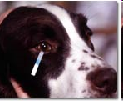
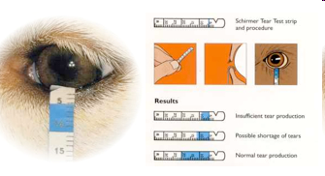
Schirmer Tear Test

Slide 28
Other Ophthalmic Drugs
Other ophthalmic drugs used to treat ocular diseases include:
  Antibiotics
  Antifungals
  Antivirals
  Corticosteroids
  NSAIDs
  Tear supplements
See Table 18-1 in your textbook for a list of
anti-infectives, anti-inflammatories, and tear supplements used in veterinary medicine

Slide 29
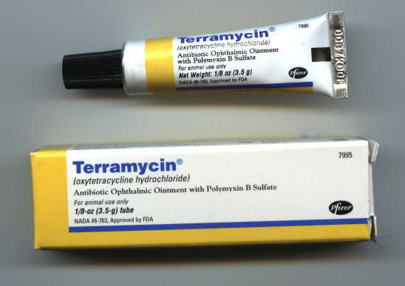
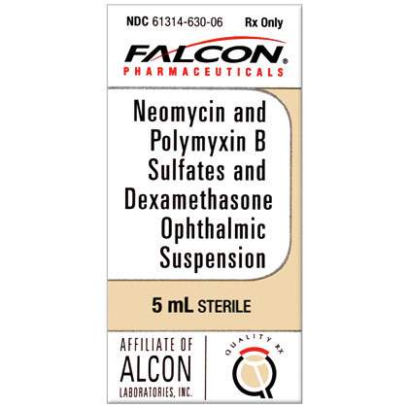
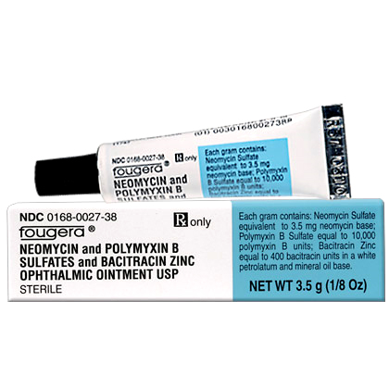
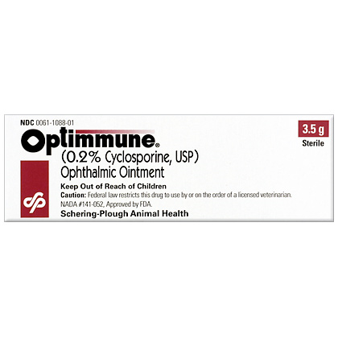
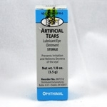
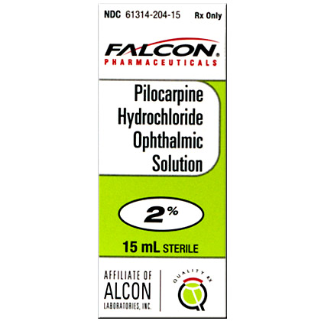

Slide 30
Basic Anatomy & Physiology
The ear is the sensory organ that allows hearing and maintains balance
The ear is comprised of three parts:
  Outer: pinna and external auditory canal
  Middle: tympanic membrane, auditory ossicles, eustachian tube, oval window, and round window
  Inner: vestibule, cochlea, and semicircular canals
Otitis interna is an inner ear infection
  Side effects include head tilt toward the infected side, ataxia, nausea, and vomiting

Slide 31
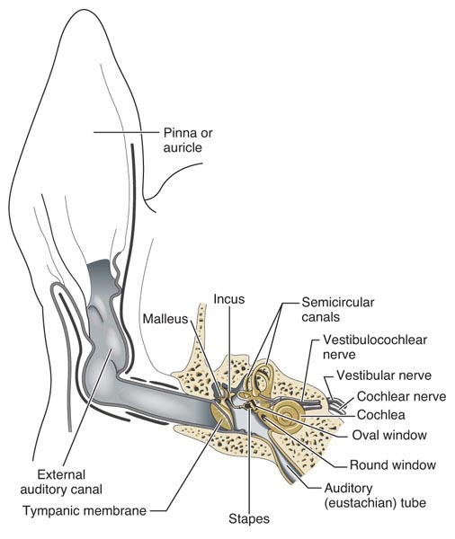
Basic Anatomy & Physiology

Slide 32
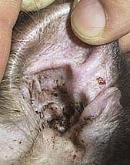
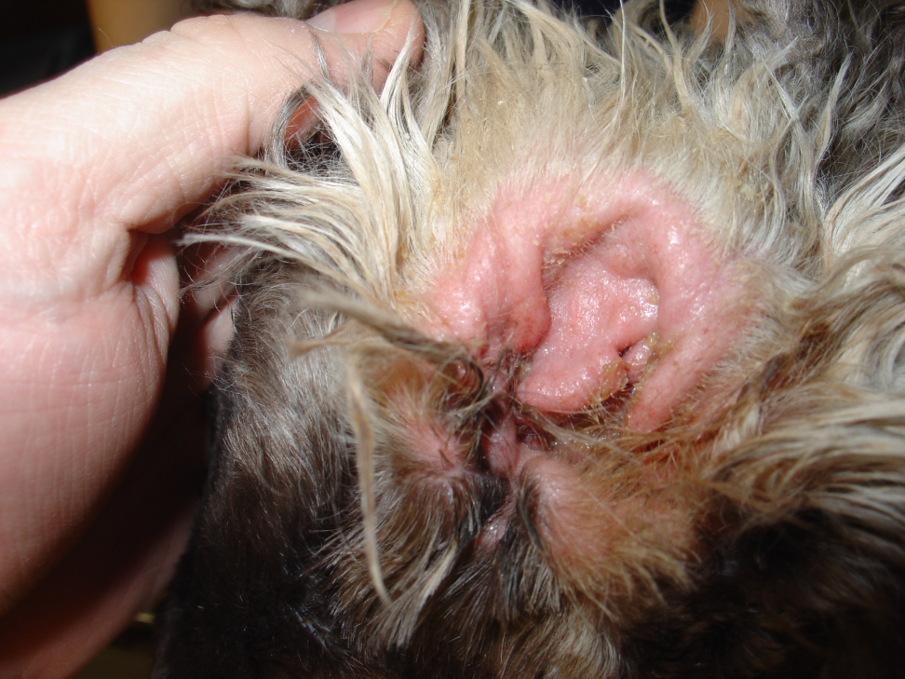
Ear Infection vs Ear Mites

Slide 33
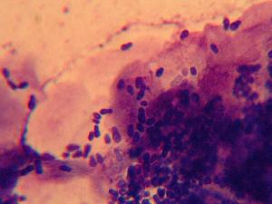
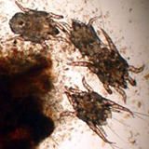
Microscopic Difference

Slide 34
Otic Medications
Many drug combinations are used in veterinary medicine to treat ear disease, including:
  Antibiotics
  Antiparasitics
  Antifungals
  Corticosteroids (in combination with anti-infectives)
  Otic drying agents
  Otic cleansing agents
  Otic dewaxing agents (cerumen = earwax)
Refer to Table 18-2 in your textbook for a complete list of otic drugs

Slide 35
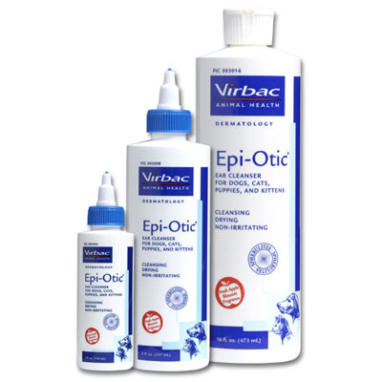
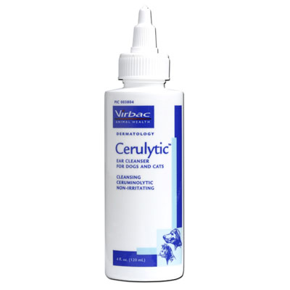
Epi-Otic & Cerulytic
Propylene glycol & salicylic acid
Ceruminolytic (propylene glycol, benzyl alcohol)

Slide 36
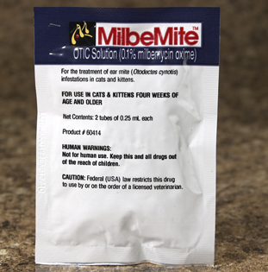
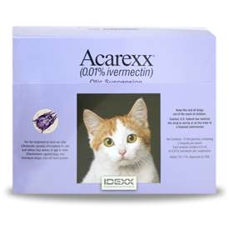
MilbeMite & Acarexx

Slide 37
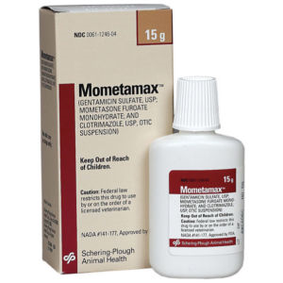
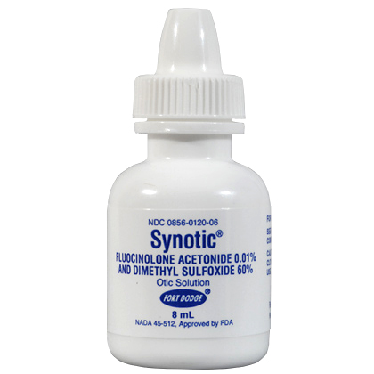
Mometamax & Synotic

Slide 38
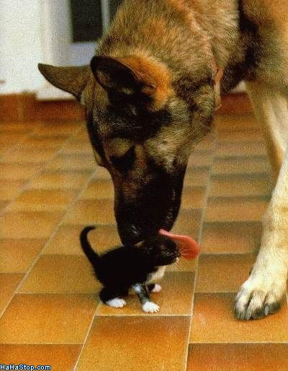
The End

